Slide 1
Telecom Churn case study
SUBMISSION
Subhabrata Ghosh(Group Facilitator)
Anusaa Vemuri( Group Member)

Slide 2
Telecom Churn Case Study
In the telecom industry, customers are able to choose from multiple service providers and actively switch from one operator to another. In this highly competitive market, the telecommunications industry experiences an average of 15-25% annual churn rate. Given the fact that it costs 5-10 times more to acquire a new customer than to retain an existing one, customer retention has now become even more important than customer acquisition..
Problem Statement: So we need to analyze telecom industry data and predict high value customers who are at high risk of churn and identify main indicators of churn.

Slide 3
Analysis approach
EDA/Missing value analysis/Imputing values/standardising data types
Identifying imbalance data set
Univariate/bi-variate analysis
Outlier detection
Deriving features
Using SMOTE to handle class imbalance
PCA (feature selection )
Evaluating inferential stats i.e accuracy,recall,precision,f score, Area under the Curve, True positive rate (TPR) for models Logistic Regression, Decision Tree, Random Forest, Boosting models ,SVM

Slide 4
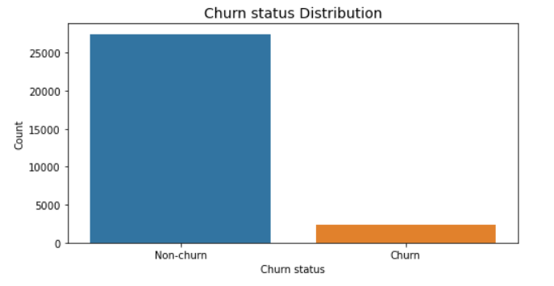
Percentage of Charged off and fully Paid loan status
Summary: imbalanced classification

Slide 5
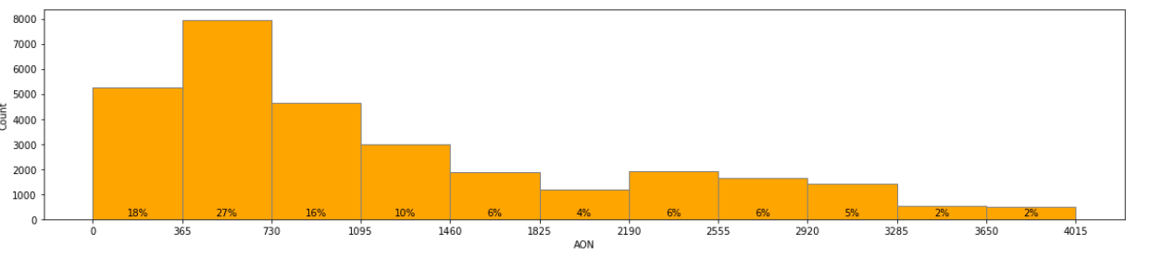
AON - Age on network
Observation:
Minimum Age on network is 180 days.
Average age on network for customers is 1200 days (3.2 years).
27% of the HV users are in their 2nd year with the network.
Almost 71% users have Age on network less than 4 years.
15% users are with the network from over 7 years.

Slide 6
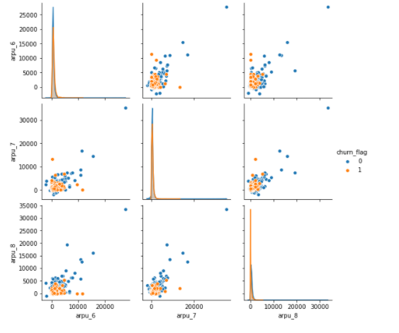

APRU - Average revenue per user
Observation:
Average revenue per user,arpu also drops significantly for churners from month Jul(7) to Aug(8).
While it remains almost consistent for the non-churners

Slide 7
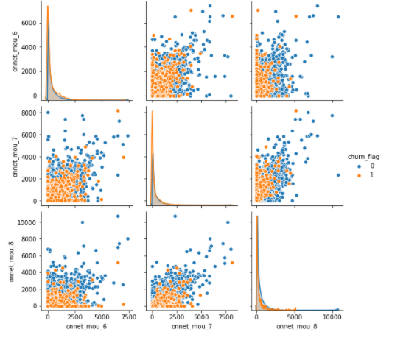
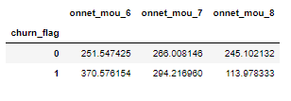
onnet_mou - On network/ within the same network usage
Observation:
Within the network monthly usage, onnet also drops significantly for churners from month Jul(7) to Aug(8).
While it remains almost consistent for the non-churners.

Slide 8
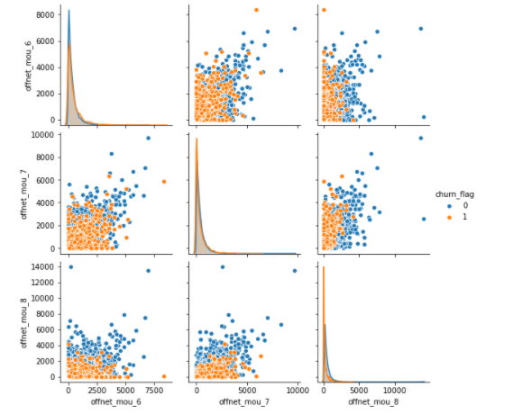

Offnet_mou - All kind of calls outside the operator T network
Observation:
Outside the network monthly usage, offnet also drops significantly for churners from month Jul(7) to Aug(8).
While it remains almost consistent for the non-churners

Slide 9
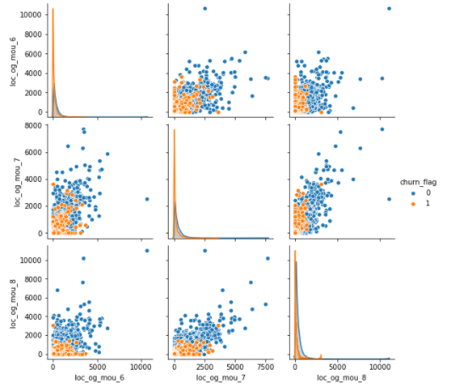
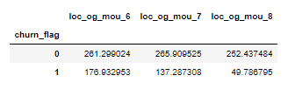
loc_og_mou - within the circle outgoing call
Observation:
local outgoing calls drops significantly for churners from month Jun(6) to Aug(8).
While it remains almost consistent for the non-churners

Slide 10
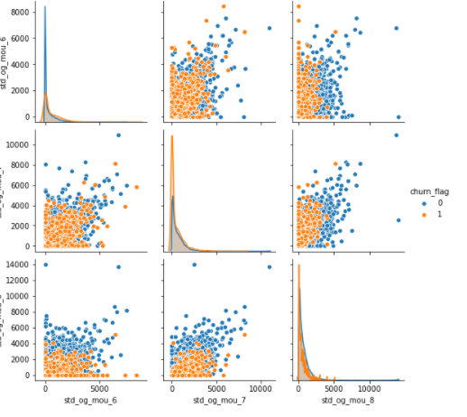
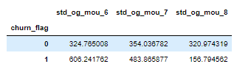
std_og_mou - STD calls - outside the calling circle
Observation:
STD outgoing calls drops significantly for churners from month Jun(6) to Aug(8).
While it remains almost consistent for the non-churners

Slide 11
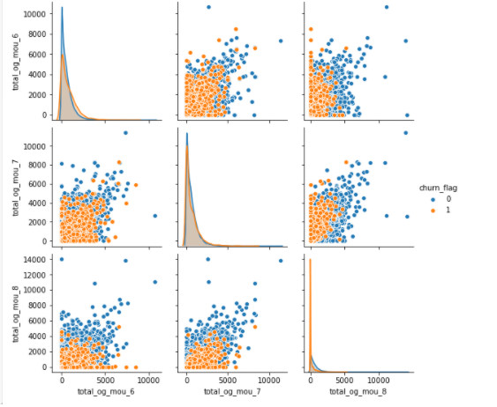
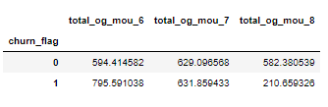
total_og_mou - Total outgoing calls per customer
Observation:
Total outgoing voice calls drops significantly for churners from month Jun(6) to Aug(8).
While it remains almost consistent for the non-churners

Slide 12
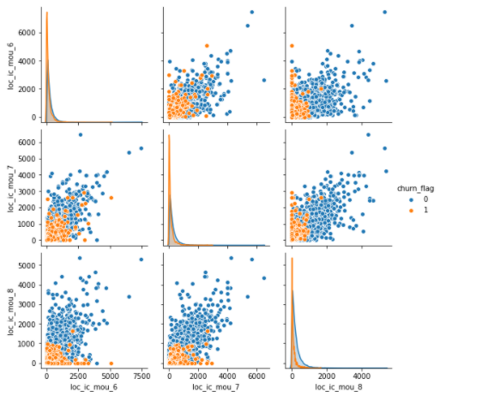

loc_ic_moc - incoming local calls
Observation:
Local incoming calls drops significantly for churners from month Jun(6) to Aug(8).
While it remains almost consistent for the non-churners

Slide 13
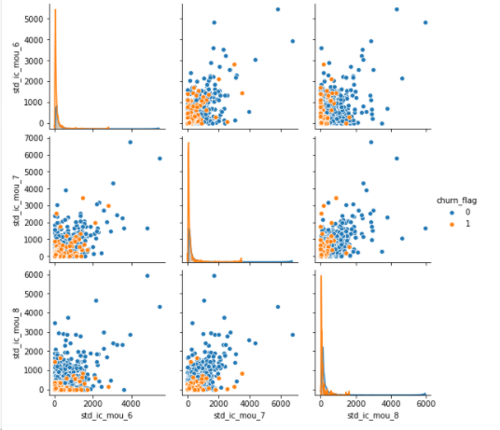
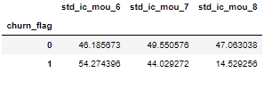
std_ic_mou - Outside the circle incoming calls / STD incoming calls
Observation:
STD incoming calls drops significantly for churners from month Jun(6) to Aug(8). Which is similar to the local incoming calls
While it remains almost consistent for the non-churners.

Slide 14
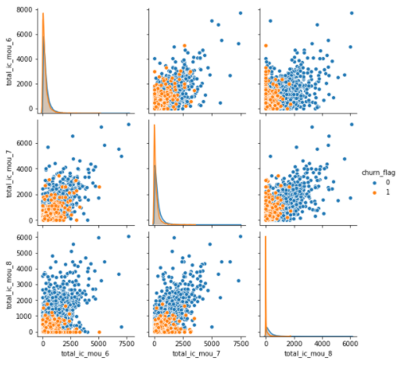

total_ic_mou - total incoming call for the person.
Observation:
As expected total incoming calls drops significantly for churners from month Jun(6) to Aug(8).
While it remains almost consistent for the non-churners

Slide 15
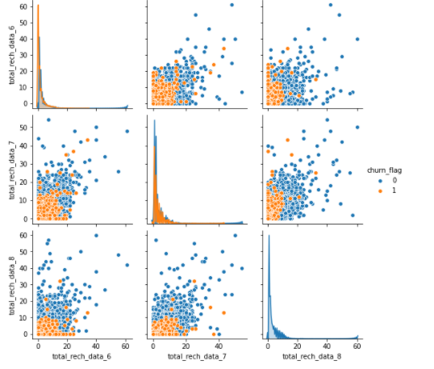

total_rech_data - Total number of times the data has been recharged
Observation:
Total data recharge dropped by 73.5% on an average from Jun(6) to Aug(8) for the churn cases

Slide 16
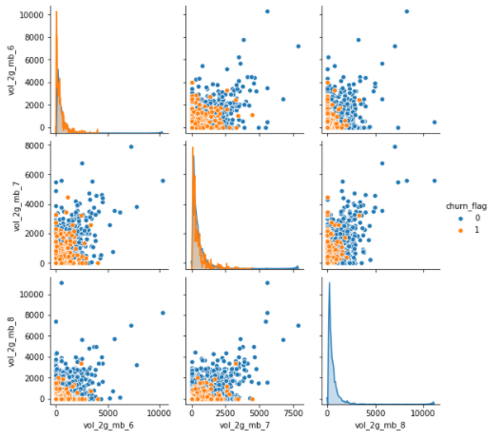

vol_2g_mb - 2G Internet usage in MB
Observation:
2G Internet usage dropped by 80% on an average from Jun(6) to Aug(8) for the churn cases

Slide 17
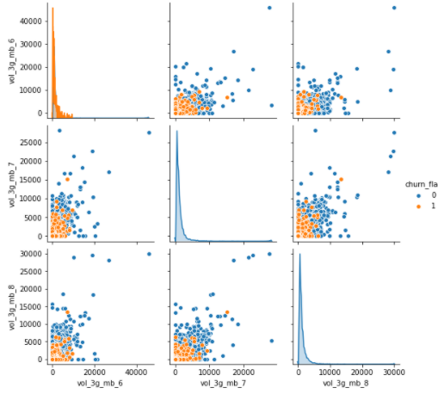

vol_3g_mb - 3G Internet usage in MB
3G Internet usage dropped by 69% on an average from Jun(6) to Aug(8) for the churn cases

Slide 18
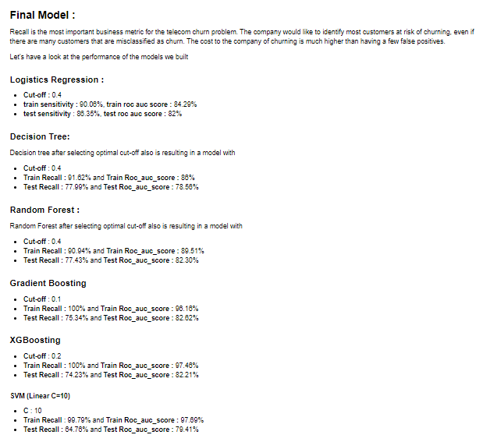
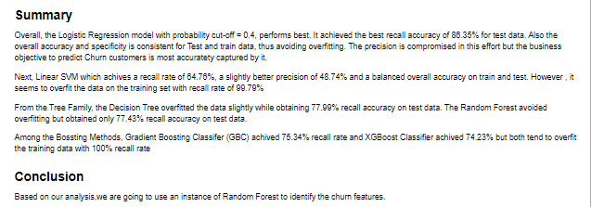

Slide 19
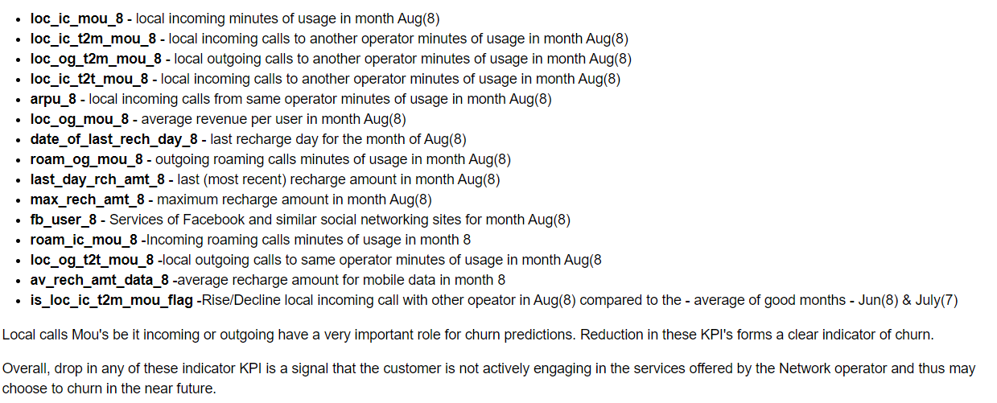

Slide 20
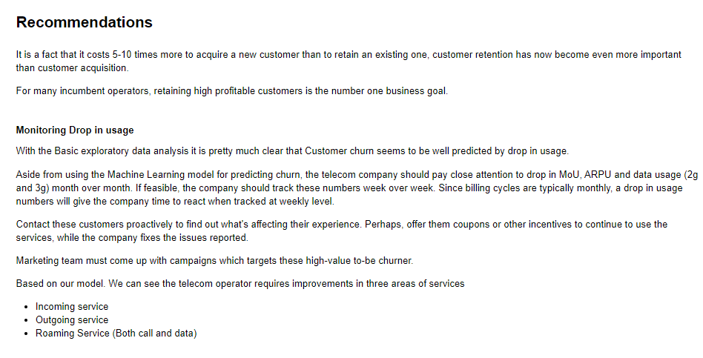

Slide 21
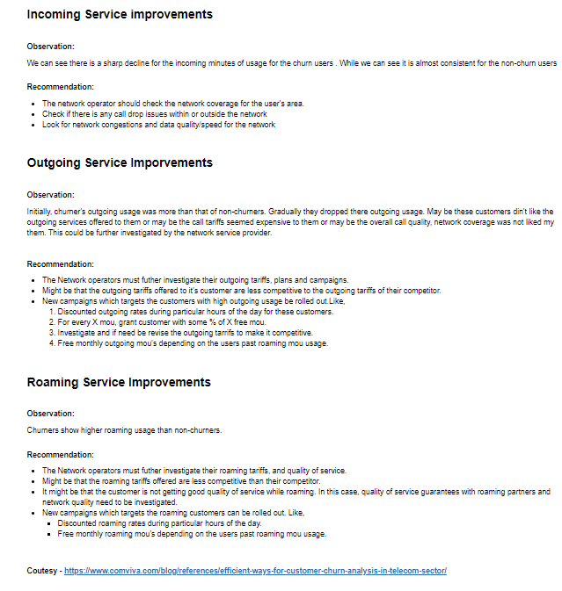

Slide 22
General Recommendations:
ARPU 7th and 8th - Average Revenue Per User decreases from 6th to 7th month to 8th month as most of the users are churned by 8th month.
date_of_last_rech_8 - Most of the Users are churned between 25th to 31st of the month. Hence providing offers prior to 25th can reduce the churn. Send out periodic offers to customers between 15th of the month to 25th of the month.
last_day_rch_amt_8 - Lower the last day recharge amount higher the churn rate. Focus on customers whose last day recharge amount has decreased. Specially for customers without any recharge amount
Strategy:
2G/3G drops hints about interesting upgrade of phones, where mobile networks can offer partnerships with premium phones(like airtel + Iphone)
create affordable family/friends group offers to reduce porting

